Slide 1
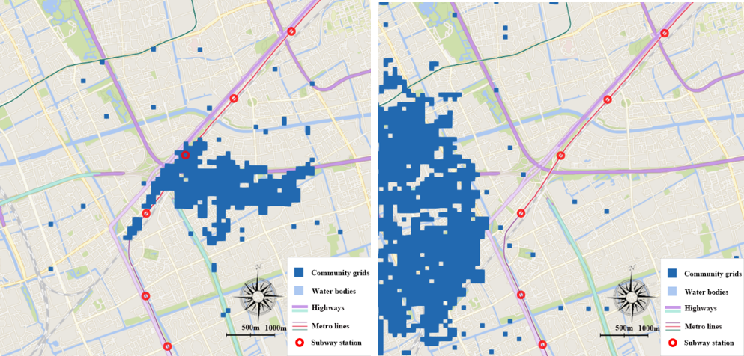
Geographical barrier discovered by shared bikes mobility patterns

